Slide 1
Deep Learning
Project proposals

Slide 2
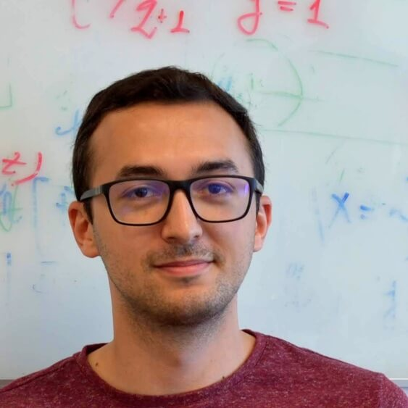
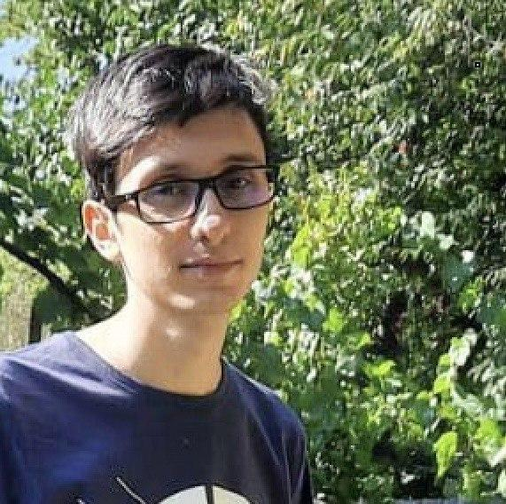

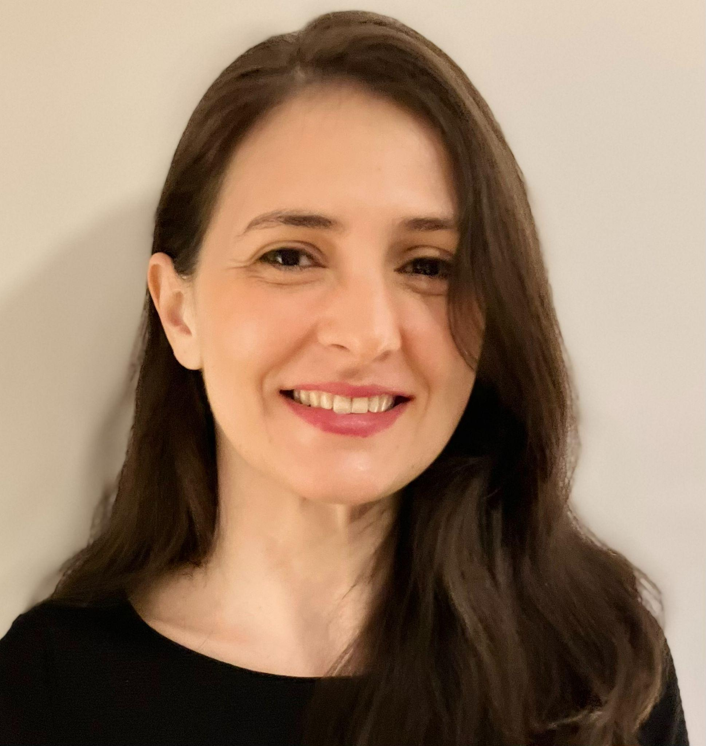

Mentors
Florin Brad
fbrad@bitdefender.com
Marius Drăgoi
mdragoi@bitdefender.com
Florin Gogianu
fgogianu@bitdefender.com
Elisabeta Oneață
eoneata@bitdefender.com
Ștefan Smeu
ssmeu@bitdefender.com

Slide 3
Steps for the Project
Select a project, team of 2 (hard deadline for choosing project: April 3)
If you are not the first team for a project, ask the mentor if you can choose it
Follow the instructions from your mentor
Read the Related Work
Choose a Dataset
Implement several Baselines in Pytorch
Comparative Analysis - variations for:
Architecture
Number of parameters
Optimization, cost function
Poster for the Project (presented in the final week)
Bonus: Submit for eeml.eu (deadline: March 29 - may be extended for 1 week)
Mandatory: Deep Learning approach for the chosen problem

Slide 4
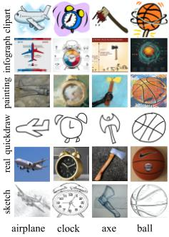
Why do foundational models generalize?
Goal
Q: Why do foundational models embeddings generalize to unseen data distributions(style)? https://arxiv.org/abs/2310.09562 (not due to train-test similarity)
Datasets
Multi-env dataset benchmarks: WILDS, DomainBed
Grading guidelines
50% - fine-tune with 2 methods
80% - fine-tune with 2 methods + a few from 2
100% - fine-tune with 3 methods + most from 2
Bonus*: Test other classification tasks (identify the style). Do fine-tune methods still generalize well?
Fine-tune foundational models with different methods
Linear probing
CLIPood
FLYP
AutoFT (no code yet)
In-depth analysis of features (what is the best embedding/why?)
Visualization TSNE/PCA for features
Visualization OTDD/KL dist for distributions
Alignment vs uniformity
Bonus**: Test methods for better OOD generalization in the embedding space (e.g. Lisa/Mixup/VRex)
ssmeu@bitdefender.com, eoneata@bitdefender.com
Notes:
TODO: GOAL

Slide 5

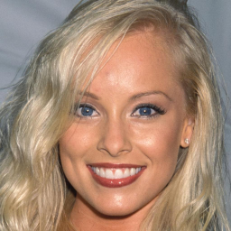
Deep Fake Image Detection
Real/Fake?
Task
Test different backbone architectures for deep fake detection of face images. Check how the models trained to detect a particular type of fakes transfer to other generation methods. (e.g. models trained on gan-generated images transfer to diffusion-generated images).
Datasets
CelebAHQ
StyleGan2 sampled images
LDM sampled images
P2 sampled images
(maybe) Face Forensics ++
Links
CNN-generated images are surprisingly easy to spot... for now
Are GAN generated images easy to detect? A critical analysis of the state-of-the-art.
What makes fake images detectable? Understanding properties that generalize
Towards the detection of diffusion model deepfakes
eoneata@bitdefender.com

Slide 6
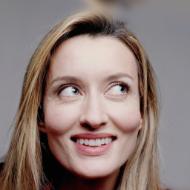
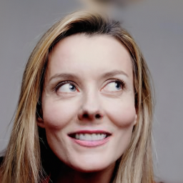
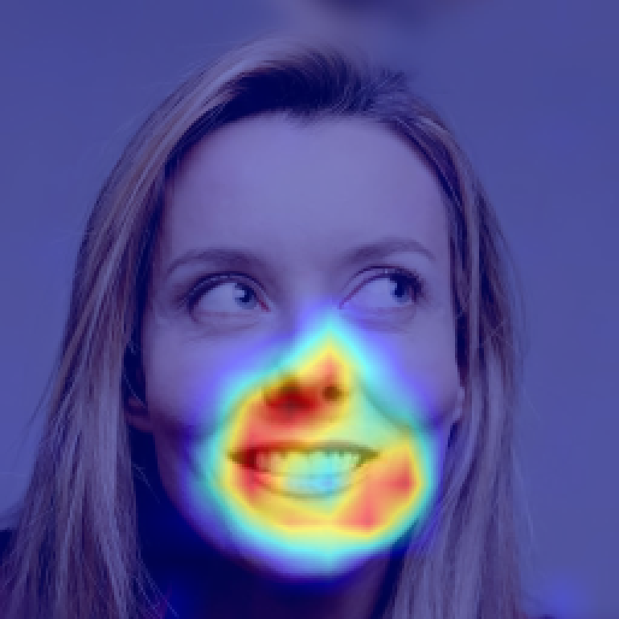

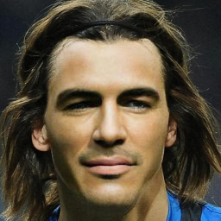
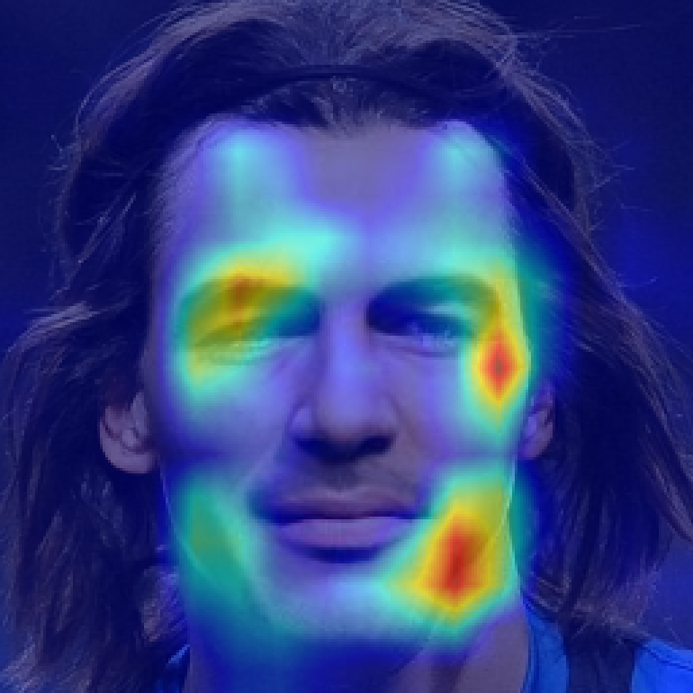
Deep Fake Localization
Task
Train networks for deep fake localization. You will experiment with different networks for image segmentation and analyze how results transfer from one deep fake generation method to another.
Datasets
Repaint
LAMA
Pluralistic
Links
CNN-generated images are surprisingly easy to spot... for now
Are GAN generated images easy to detect? A critical analysis of the state-of-the-art.
What makes fake images detectable? Understanding properties that generalize
Towards the detection of diffusion model deepfakes
eoneata@bitdefender.com

Slide 7
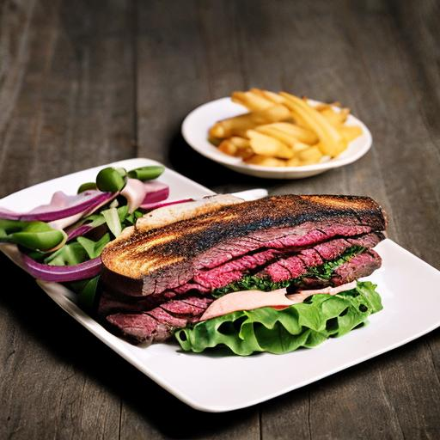
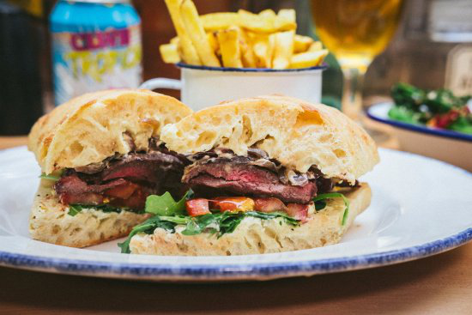
General Deepfake Detection
Real/Fake?
Context. One of the main challenges in deepfake detection is building a detector capable of generalizing to images produced with different generation methods than those seen at training.
Task. Investigate the generalization capabilities of pretrained self-supervised features for deepfake image detection.
Details. You will experiment with and extend the method presented in this paper. You can start from this code that provides a trained linear classification layer on top of features extracted from CLIP. This model is trained on GAN-generated data. Your tasks will be to:
Test the provided model for classification of deepfake images from latest diffusion models. Specifically, you will use for testing the validation test provided in this challenge. Compare the obtained results with those provided on other diffusion models.
Modify the approach to rely on image features extracted from other powerful image encoders (eg. SAM) instead of CLIP
Train a classifier on top of these features using GAN-data.
Compare the results obtained with CLIP and those obtained with SAM features.
eoneata@bitdefender.com, ssmeu@bitdefender.com

Slide 8
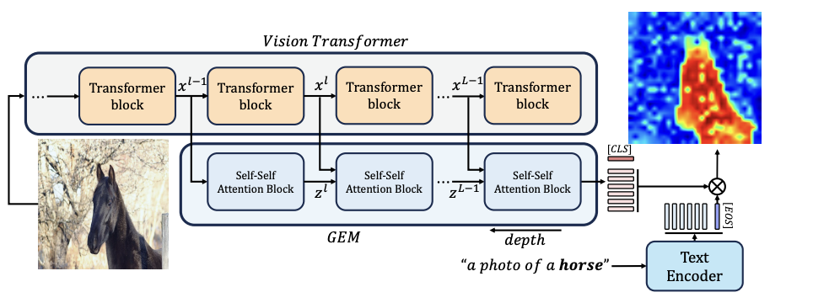
Weakly Supervised Localization with CLIP
Context: Recently, large pretrained (text-images) models (e.g. CLIP) have shown remarkable transfer capabilities. In this project we investigate whether it is possible to implicitly localize various objects described by text.
Task: Analyze the zero-shot localization capabilities of CLIP models using 3 methods on COCO dataset:
Grad-CAM: Visual Explanations from Deep Networks via Gradient-based Localization (GradCam-CLIP example)
Grounding Everything: Emerging Localization Properties in Vision-Language Transformers
Interpreting CLIP's Image Representation via Text-Based Decomposition
Image from: Grounding Everything: Emerging Localization Properties in Vision-Language Transformers, Walid Bousselham, Felix Petersen, Vittorio Ferrari, Hilde Kuehne (CVPR 2024)
eoneata@bitdefender.com, ssmeu@bitdefender.com

Slide 9

Covid Fake News Detection
Task: given a social media post discussing Covid-19, classify it as real or fake
Resources: dataset paper, dataset, task website, DL approaches paper
Grading guidelines
70% - finetune BERT/LLM on classification task directly
100% - compare several LM models (BERT, Covid-BERT etc.)
fbrad@bitdefender.com, mdragoi@bitdefender.com

Slide 10
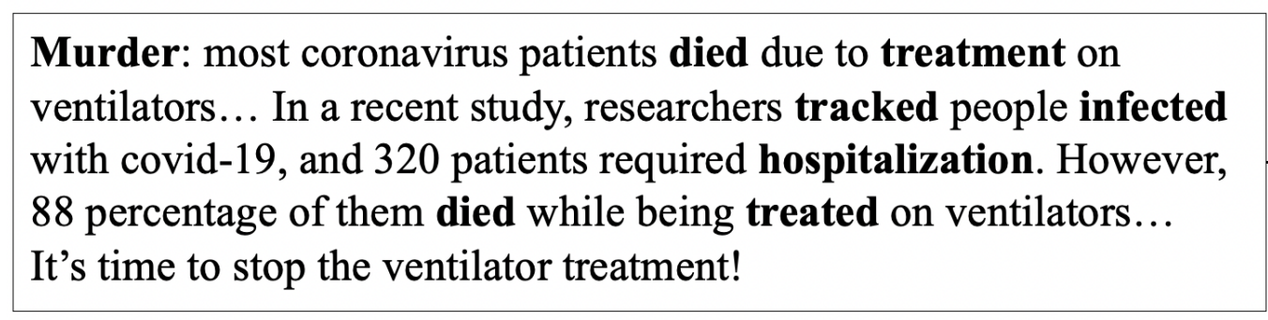
Conspiracy detection PAN 2024
Task: given a text, detect if it’s conspiracy or public messaging
Resources: https://pan.webis.de/clef24/pan24-web/oppositional-thinking-analysis.html
Grading guidelines
70% - finetune BERT/LLM on classification task directly
100% - compare several LM models (BERT, Covid-BERT etc.)
conspiratorial text
critical text
fbrad@bitdefender.com, mdragoi@bitdefender.com

Slide 11
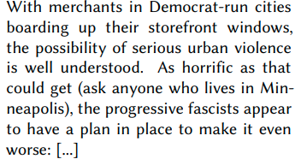
Fake News Detection
Task: given an article, predict whether the main claim is true, partially true, false or other
Resources:
task website
dataset: link1, link2
overview CLEF 2021 paper
Grading guidelines
70% - finetune BERT/LLM on classification task directly
100% - compare several LM models (BERT, Covid-BERT etc.)
true
partially true
false
other
fbrad@bitdefender.com, mdragoi@bitdefender.com
Notes:
Other related tasks: Conspiracy detection, Conspiracy stance detection https://www.cmu.edu/ideas-social-cybersecurity/news1/blog-posts/blog-phillips-hoaxes-hidden.html

Slide 12
Ad Hominem Detection
Task: given a Reddit post, determine whether it contains an Ad Hominem attack
Resources:
paper 1, paper 2
dataset
Grading guidelines
70% - finetune LM on dataset
100% - minority class reweighting analysis
Augmented recurrent neural networks, and the underlying technique of attention, are incredibly exciting. You’re so wrong and a f*ucking idiot! We look forward to seeing what happens next
ad hominem
clean
fbrad@bitdefender.com, mdragoi@bitdefender.com

Slide 13
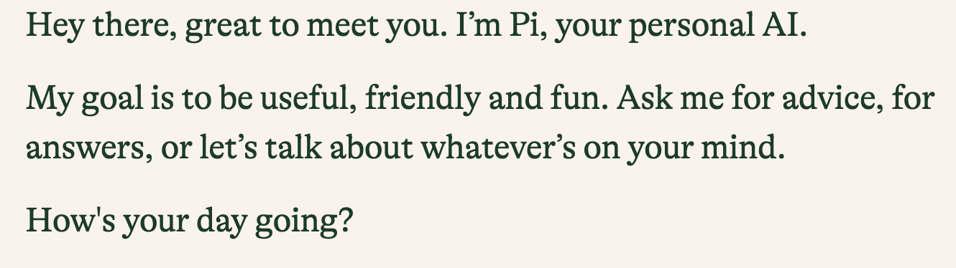
Detect human or machine text
Task: given a text, determine if it was generated by a model or written by a human (2 classes)
Resources
paper:
datasets: PAN, CodaLab
Grading guidelines
70% - finetune BERT/LLM on classification task directly
100% - compare several LM models (BERT, Covid-BERT etc.)
machine generated
human
fbrad@bitdefender.com, mdragoi@bitdefender.com

Slide 14
Detect generation source of text
Task: given a text, determine who generated (human or specific model)
Resources:
https://arxiv.org/abs/2305.14902
https://pan.webis.de/clef24/pan24-web/generated-content-analysis.html
https://github.com/mbzuai-nlp/M4
human
chatGPT
LLaMA
Flan-T5
BloomZ
fbrad@bitdefender.com, mdragoi@bitdefender.com

Slide 15
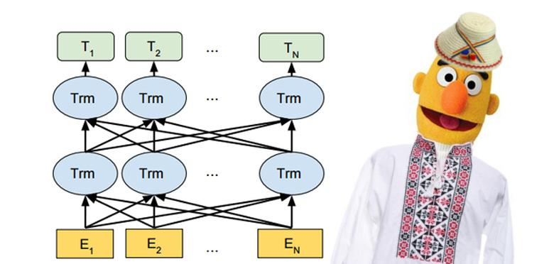
Self-Supervised Learning: Text Features from Language Modelling
Goal
Train a BERT/Romanian BERT language model on a romanian corpus
Transfer knowledge to a downstream task
Datasets
OSCAR (pretraining), LiRo (pretraining, target task)
Links
https://oscar-corpus.com/post/oscar-v22-01/
https://lirobenchmark.github.io/
https://arxiv.org/pdf/2009.08712.pdf
Grading guidelines
80% - finetune BERT on classification task directly
100% - domain-adaptive pretraining, followed by finetuning on classification task
Bonus: Submit a model to LiRo, compare several LM models
fbrad@bitdefender.com, mdragoi@bitdefender.com

Slide 16
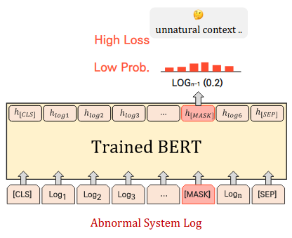
Anomaly detection in network logs
Task: Discriminate anomalous logs (outliers) from benign logs (inliers) using language modelling in unsupervised or self-supervised fashion
Expectation:
Use a RNN (LSTM/GRU) or a Transformer Model (BERT) to learn the inlier distribution
Compute an anomaly metric for the test samples and evaluate the model using ROC-AUC between your anomaly scores and dataset labels
Dataset:
CICIDS2018: https://www.unb.ca/cic/datasets/ids-2018.html
Resources:
RNN for log anomaly detection: https://arxiv.org/pdf/1803.04967.pdf
LAnoBERT: https://arxiv.org/pdf/2111.09564.pdf
OE: https://arxiv.org/pdf/1812.04606.pdf
Scoring:
80%
Correctly train a simple model in the given setup
Correct plots for train/test splits
100%
Obtain good performance
Analyze anomaly detection rate based on outlier class (CICIDS2018 labels: Bruteforce attack, DoS attack, Botnet attack etc.)
Comparison: split data by timestamp (test on different period than the train data) vs random split
Bonus: Outlier Exposure
Anomaly score computation (Source: LAnoBERT)
mdragoi@bitdefender.com

Slide 17

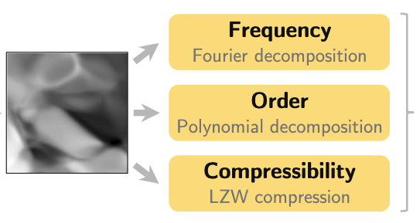
Estimator complexity in RL
Context
Neural networks exhibit training difficulties in Deep Reinforcement Learning
We hypothesize that these issues are correlated with complexity measures
Task
Train neural network value-function estimators in the policy evaluation setting under the following objectives / loss functions:
TD(0)
Monte-Carlo returns
Regression to the true value function
Measure their frequency, polynomial order and compressibility measures of complexity and compare given the loss function
Links
Neural redshift: random networks are not random functions
The primacy bias in deep reinforcement learning
Architecture
Loss function
florin.gogianu@gmail.com

Slide 18
Images courtesy of...
https://20bn.com/datasets/jester
https://github.com/maximecb/gym-minigrid
https://www.elmundotech.com/2015/02/25/googles-deep-mind-creates-an-ai-system-to-beat-video-games-by-itself/
https://aws.amazon.com/blogs/machine-learning/detecting-fraud-in-heterogeneous-networks-using-amazon-sagemaker-and-deep-graph-library/
https://www.dynamicciso.com/dark-nexus-the-evolving-iot-botnet-targets-variety-of-devices-says-bitdefender-research/
https://studentwork.prattsi.org/infovis/visualization/amazon-product-co-purchasing-network-information-visualization/
https://github.com/tkarras/progressive_growing_of_gans

